Slide 1
Project Progress Report
DOT Traffic Ops database migration project
Jason Wu, Hyun Soo Lee

Slide 2
Background, Goals, Objectives
Background: The current database that NYC DOT Traffic Ops is using to store relevant information on crossing signals is slow to respond to input, takes up excessive and redundant storage, is user unfriendly, and requires dedicated maintenance.
This project intends to resolve this problem by creating a new database and User Interface that will replace the existing database and UI and port over all existing data.

Slide 3
Front end
One part of our project requires us to produce a User Interface (UI) that prospective users will use to interact with the database.
The UI will provide the user the ability to create, modify, and delete data points stored in the database.
The UI will provide the user the ability to create reports and queries based on one or more data points.
The UI will display data points overlayed on an interactive map.

Slide 4
Back end
Another part of our project requires us to produce a database that can store DOT Traffic Ops data in a more efficient manner.
The database will respond to user requests from the UI and modify its contents (adding, changing, or deleting data points) accordingly.
Compared to the existing database, the new database should respond to requests with less latency and take up less memory.

Slide 5
Process
Front and back ends
User Interface
Database and server
Testing
Ensure functional UI
Ensure responsive database
Data migration
Clean data from old database
Parse data to new database

Slide 6
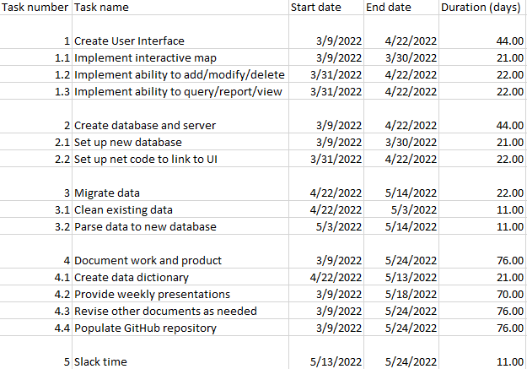
Current work breakdown

Slide 7
Demonstration
Since we have just entered the programming portion of the project, we currently do not have any demonstrable material.

Slide 8
Communication Plan
Name | Title | Frequency | Format, Channel | Notes
Maddalena Romano | Sponsor, Stakeholder | Weekly | Presentations via Zoom, other issues via email
Bill Harrison | Stakeholder | Asynchronous | Presentations via Zoom if present, other issues via email as needed
Type | Method | Frequency | Goal | Owner | Audience
Progress Report | Presentation via Zoom | Weekly, every Wednesday | Inform audience of the state of the project as of each report | Project Managers | Stakeholders, Customers

Slide 9
Questions, contact
Contact info (Jason Wu):
(347)274-4302, zehong.wu@macaulay.cuny.edu
Contact info (Hyun Soo Lee):
hsleenet@gmail.com

Slide 10
Schedule for next steps
Begin work on User Interface
Begin work on database
Continue work on previous nodes in parallel

Slide 11
Schedule for Workflow diagram
Planning
Execution
Monitoring

